Slide 1
Welcome
CS771: Introduction to Machine Learning

Slide 2
Course Details
Number: CS771
Name/Title: Introduction to Machine Learning
Admin Team: wait for next slide
Website: https://www.cse.iitk.ac.in/users/purushot/courses/ml/2023-24-w/
Videos (YouTube): https://www.youtube.com/c/MLConversations
Discussion (Piazza): https://piazza.com/iitk.ac.in/secondsemester2024/cs771
Slides, code, notes (GitHub): https://github.com/purushottamkar/cs771

Slide 3
Admin Team
SNo | Admin Name | Prog | Email (@cse.iitk.ac.in) | Interests
1 | Subhajyoti Saha | PhD | subhajyoti | Machine Learning
2 | Jegan Balaji B S | MS | jeganb | Graph mining, Recommender systems
3 | Avnish Tripathi | MTech | avnish | ML in healthcare
4 | Divyesh Devangkumar Tripathi | MTech | bittu | Computer Vision
5 | Hammad Ansari | MTech | hammad | Systems
6 | Kartick Verma | MTech | kartickv | NLP and applied ML
7 | Kush Shah | MTech | kushshah | Bilevel optimization
8 | M N V Ramachandra Ananthapalli | MTech | mnvrama | Full stack development
9 | Manik Shekhar | MTech | manik | Virtualization
10 | Nihal Thukarama Rao | MTech | nihal | Computer Vision, NLP, GPGPU computing
11 | Pranjal Kumar Srivastava | MTech | pranjalks | Machine Learning, Deep Learning
12 | Samarth Joshi | MTech | samarth | Algorithms

Slide 4
Admin Team
SNo | Admin Name | Prog | Email (@cse.iitk.ac.in) | Interests
13 | Sanket Kale | MTech | sanket | Machine Learning Theory
14 | Shubhashish Moitra | MTech | smoitra | Machine Translation and Model Exfiltration
15 | Subhajit Panday | MTech | subhajitpanday | Machine Learning
16 | Kakumanu Vamsee Krishna | MTech | vamsee | Side Channel Attack and Analysis, Image Reconstruction from EM Leakages, Deep Learning - Image Processing & Classification
17 | Yash Uttamchandani | MTech | yashlu | Machine Learning
18 | Aditya Kankriya | MTech | adityakankriya | Computer Vision, Software Development
19 | MitrajSinh Chavda | MTech | mbchavda | Machine Learning, Encryption, Blockchain
20 | Yogesh Shrivastava | MTech | yogesh | Cybersecurity
21 | Anubhav Dixit | PhD | anubhavdixit | Computer Vision and Deep Learning for Healthcare
22 | Debkanta Chakraborty | PhD | debkanta | Optimization techniques in ML, Probabilistic ML, Computational Genomics, Bioinformatics
23 | Shivam Pal | PhD | pshivam | Machine Learning
24 | Kuruma Abhinav | MS | abhinav | Linux

Slide 5
Auditors
Please email the instructor purushot@cse.iitk.ac.in to get enrolled
Auditors will have access to
Lecture videos, slides, code, notes
Assignment, quiz and exam questions and solutions
We regret our inability to extend the following services to auditors
Submit assignments and receive graded submissions
Appear for quizzes, examinations and receive graded answer scripts

Slide 6
Grading Scheme
20%: Quizzes
30%: Assignments
20%: Mid-sem Exam
30%: End-sem Exam

Slide 7
Quizzes
Two quizzes to be conducted – each worth 10%
Tentatively scheduled on Jan 24, 2024 (Wed), Mar 20, 2024 (Wed)
Only registered students can appear for quizzes (no auditors)
Syllabus for each quiz will cover roughly 3-4 weeks – short quiz
If you are regular with lectures, discussion hours, practice questions, then you should not have to prepare too much for these quizzes

Slide 8
Assignments – 30%
Three mini projects (weightage TBA)
Replaces the single semester-long project in previous offerings of CS771
To be done in groups of five (5) students each – 2-3 weeks for each project
Start forming your group-of-5 today
Will ask you to submit group details once add-drop is over
Groups can only contain registered students (no auditors)
Create a homepage on CC/CSE home servers
Submission will include code + report
Code should be in Python – start learning Python today
Report should be in LaTeX – start learning LaTeX today

Slide 9
Extra Classes
Two institute holidays clashing with course schedule
26 January 2024: Republic Day
08 March 2024: Maha Shivratri
Two extra classes to be held to compensate
07 February 2024 (Wednesday), 6PM L20
10 April 2024 (Wednesday), 6PM L20
Note that all extra classes are on Wednesdays

Slide 10
Reference Material
No single textbook for the course
List of reference material is up on course website
Python Resources: several available – choose your favourite
www.geeksforgeeks.org/python-programming-language/
LaTeX resources: several available – choose your favourite
www.overleaf.com/learn/latex/Tutorials

Slide 11
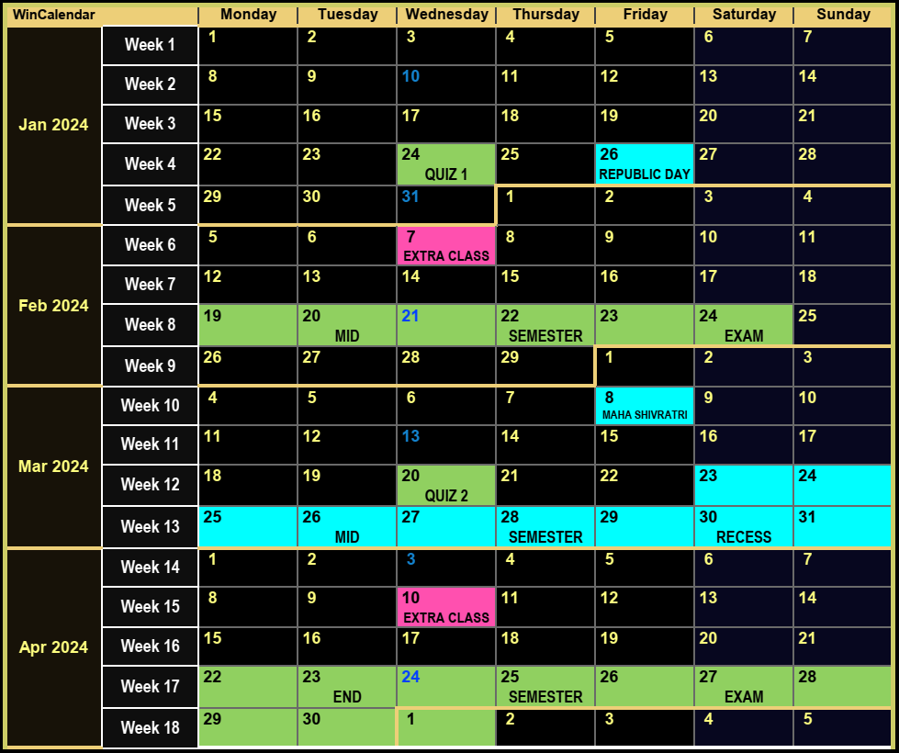





Course Website
Detailed syllabus for this course
Course calendar: schedule for holidays, exams, quizzes
Course policy: assessment, course drop, make-up
Use of unfair means, penalties and safeguards
Course etiquettes

Slide 12
A Summary of To-Dos for You
Everybody
Refresh your calculus, probability theory, linear algebra basics
Start learning/refreshing Python and LaTeX skills
Create a homepage on CC/CSE home servers
Students who are already registered
Start forming groups of five (5) students – do not wait long
Students who wish to audit
Send an email to the instructor if not already done so
Students who wish to credit
Apply during add-drop – will use published policy to accept
Policy: https://www.cse.iitk.ac.in/users/purushot/courses/ml/faq.html

Slide 13
A Teaser
What is the point of machine learning?
A few cool ML apps developed by your peers

Slide 14
What is the point of ML anyway?
“
“
The art and science of dealing with uncertainty
The art and science of designing adaptive algorithms
ML is a way to uncover hidden patterns in data
ML is a way to automate tedious and repetitive tasks
ML is a way to predict the future by looking at the past
At a high-level ML does this by
Looking at lots of data to examine input-output behaviour
Replicate that behaviour by writing a program

Slide 15







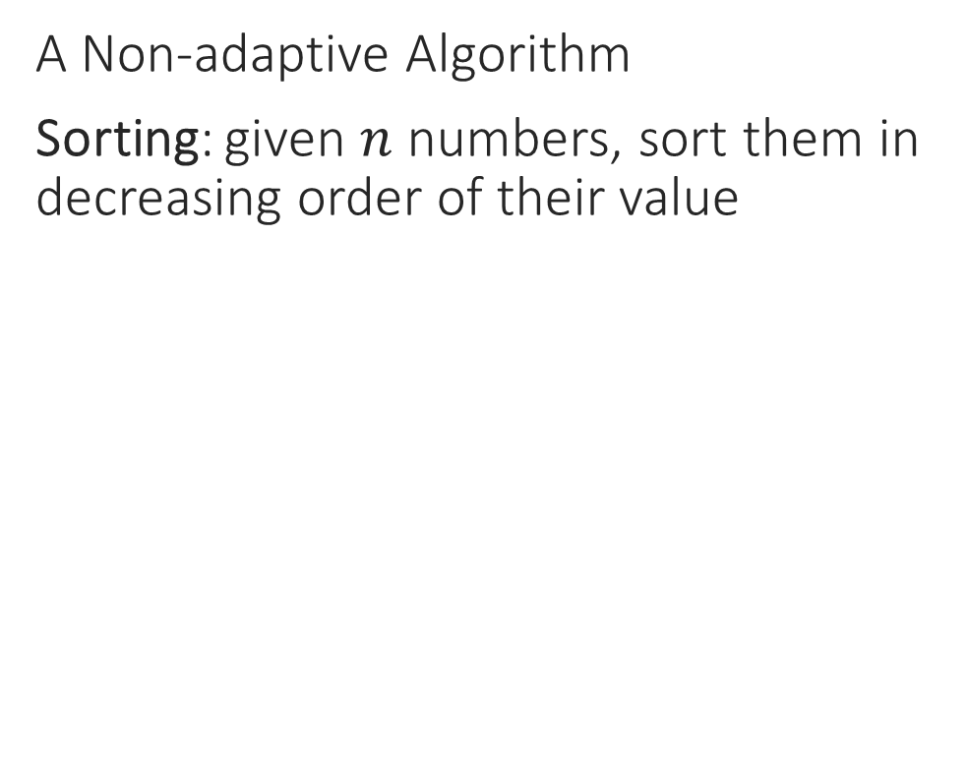
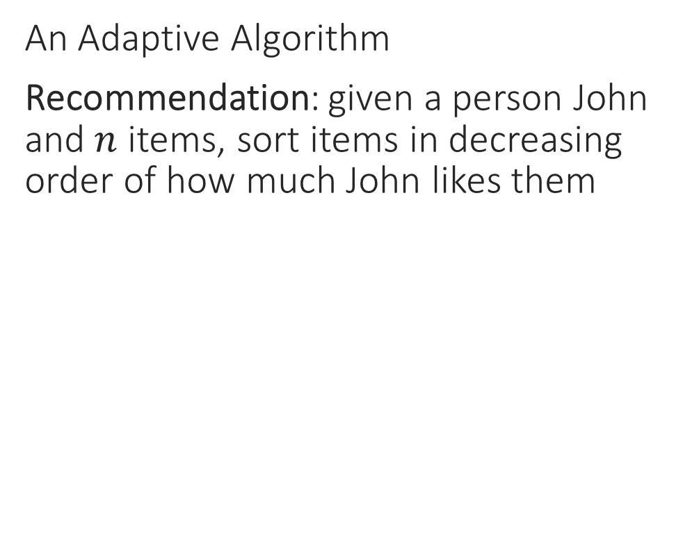
Machine Learning
“
“
The art and science of designing adaptive algorithms
The art and science of dealing with uncertainty
A Non-adaptive Algorithm
Sorting: given $n$ numbers, sort them in decreasing order of their value
An Adaptive Algorithm
Recommendation: given a person John and$n$ items, sort items in decreasing order of how much John likes them
INPUT
OUTPUT
INPUT
OUTPUT
4
9
5
5
1
7
-6
4
5
5
4
1
9
4
-3
0
ML can help you learn patterns that allow you to sort the same set of items differently for each person according to their taste
3
3
-2
-2
7
2
1
-3
2
1
0
-6

Slide 16
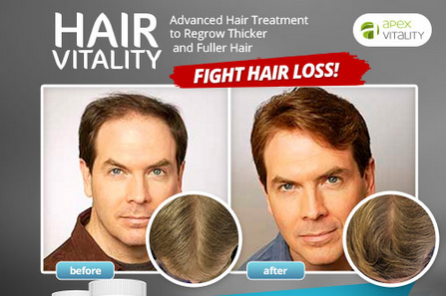
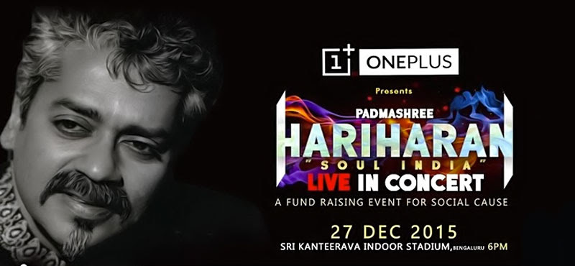
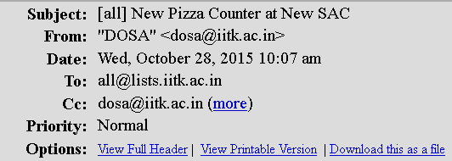
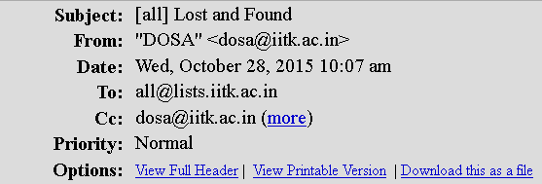
Machine Learning
“
“
The art and science of designing adaptive algorithms
The art and science of dealing with uncertainty

Slide 17
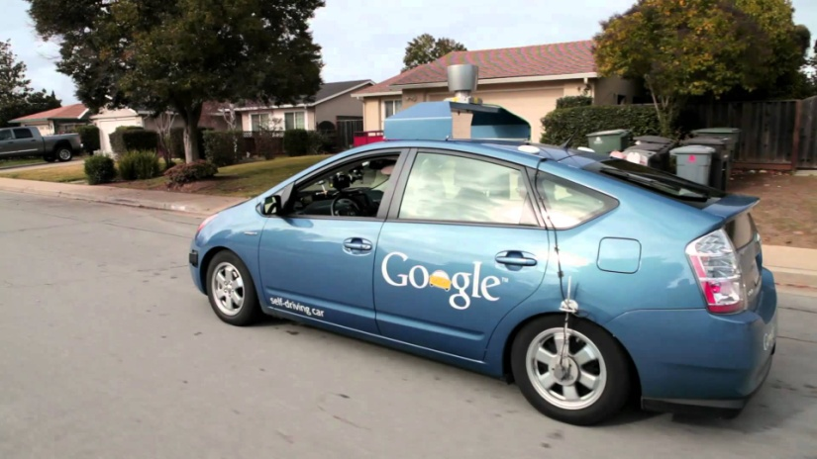
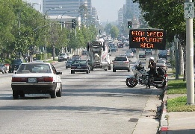
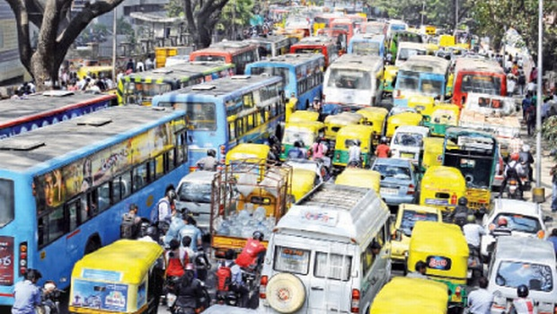
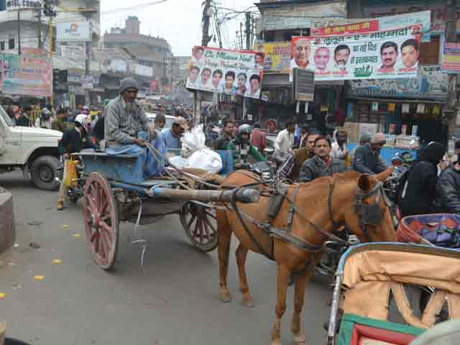
Machine Learning
“
“
The art and science of designing adaptive algorithms
The art and science of dealing with uncertainty

Slide 18










When to apply ML
Complexity: no “closed form” solutions
Humans cannot specify simple rules to get solution
Detecting spelling mistakes not a good ML problem
A simple dictionary lookup (binary search) is enough
Presence of immense variety
Too many variants to be solved independently
Correcting spelling mistakes a very good ML problem
Need for automation
Scalability and speed are main criterion
Do we need to automate medicine, driving?
macine
macine
machine

Slide 19
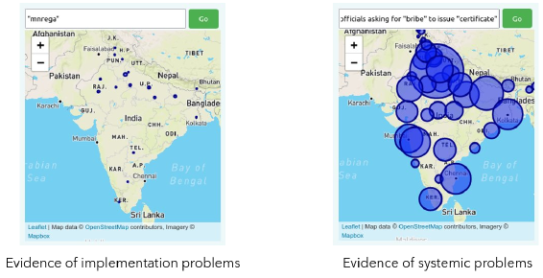
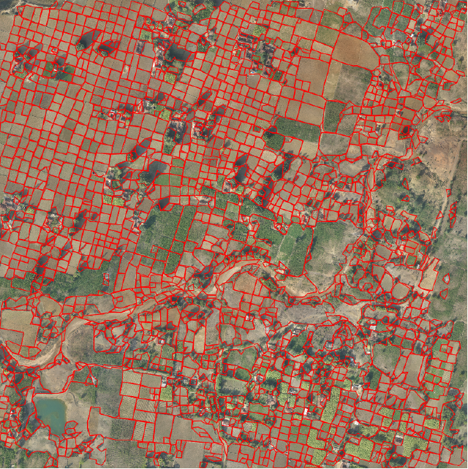
ML for e-Governance
A novel search engine for public grievances at the MoD
Emergency warning / dispatch systems
Accountability
Estimate income of citizens
Determine eligibility for public benefits services
Convert existing pull model to a push model
Automatically recognize land parcel boundaries in rural areas
Identify infrastructure damage on national highways
Assess volume of material moved at mining sites

Slide 20
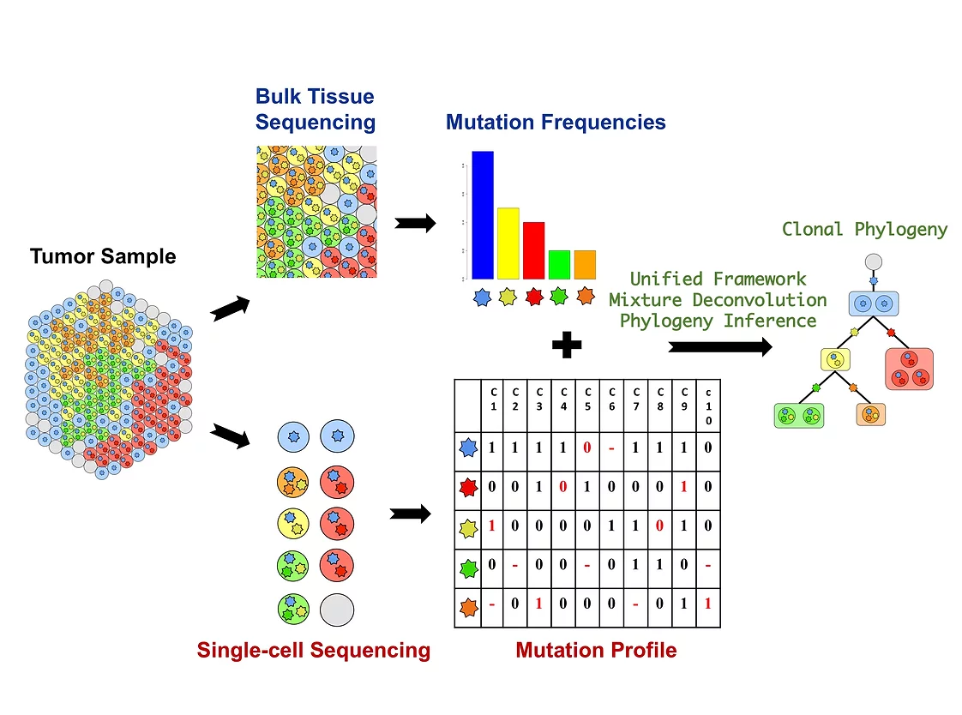
Understanding Cancer Progression with ML
Understand intratumor heterogeneity
Better diagnosis and treatment
Reduce relapse and drug resistance

Slide 21
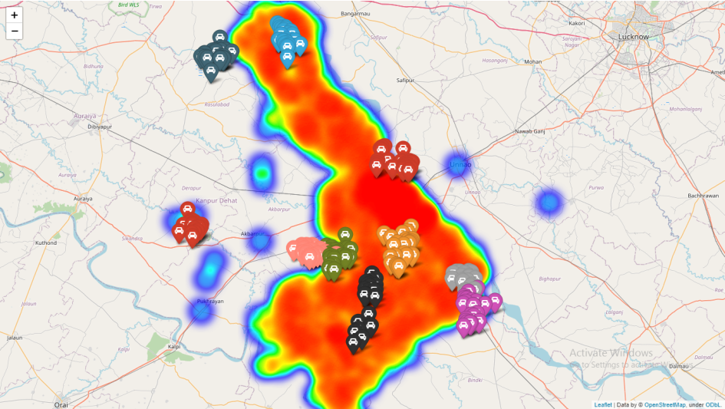
Efficient Policing with ML
Suggest reasonable patrol locations and routes based on call records
Promote fuel economy, reduce response time

Slide 22




Reveal Cybersecurity Vulnerabilities

Slide 23
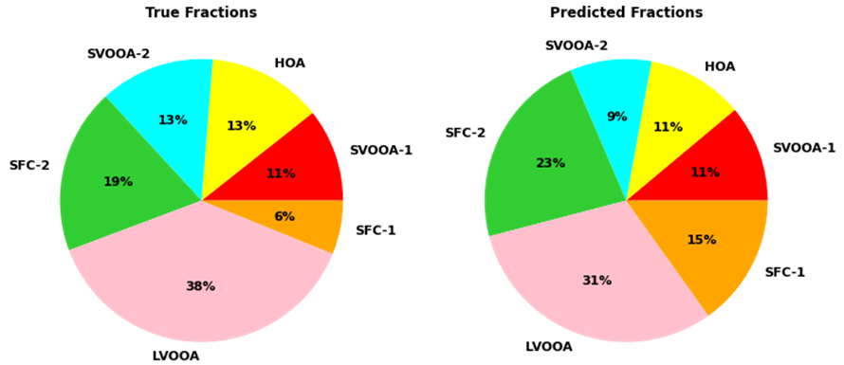
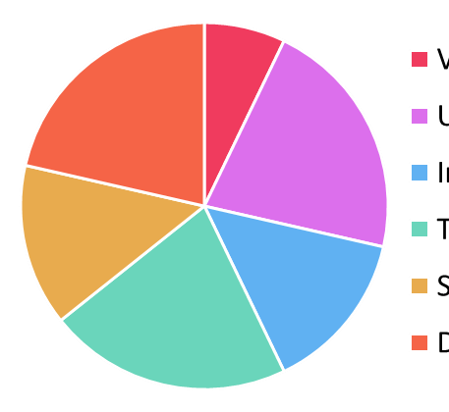
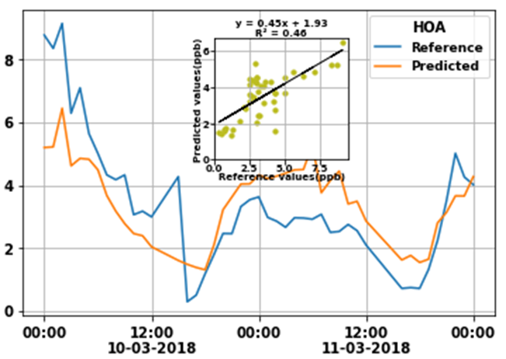
Clean Air with ML
Vehicular Pollution
Urban Organic Aerosols
Industrial Emissions
Transported Organic Aerosols
Biomass Combustion
Dust Related
An example of Hydrocarbon-like Organic Aerosol (HOA) levels predicted by a machine learning algorithm for a period of two days. The algorithm tracks well the peaks and dips in HOA levels

Slide 24



Anomaly Detection in Satellites
Fully autonomous missions a lofty goal in space exploration
Space missions still rely on ground staff support
Vast amounts of telemetry sent to mission control to be manually inspected
Expert ground staff provide remediation telecommand in case of anomaly
Early detection key to success of this setup
Enable ground staff to quickly take curative action
Critical to preserving spacecraft and mission health
Telecommand
Telemetry

Slide 25
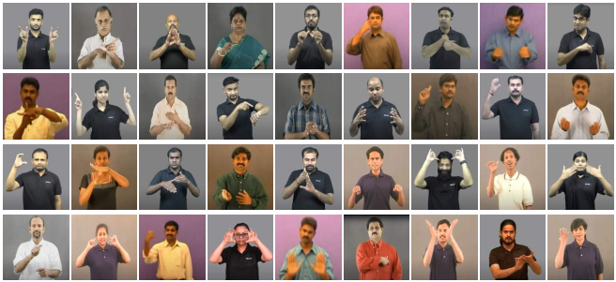
Sign Language Understanding

Slide 26
Program Correction with ML
IITK offers a C programming course to ~1000 students each year
#include <stdio.h>
int main(){
int a;
scanf("%d", a);
printf("ans=%d",a+10);
return 0;
}
#include <stdio.h>
int main(){
int a;
scanf("%d", &a);
printf("ans=%d",a+10);
return 0;
}
Line-4, Column-9: warning: format ‘%d’ expects argument of type ‘int *’, but argument 2 has type ‘int’

Slide 27
Program Correction with ML
IITK offers a C programming course to ~1000 students each year
#include <stdio.h>
int main(){
int x, x1 ,d;
d=(x-x1)(x-x1);
return d;
}
#include <stdio.h>
int main(){
int x, x1 ,d;
d=(x-x1)*(x-x1);
return d;
}
Line-4, Column-11: error: called object type ‘int’ is not a function or function pointer

Slide 28
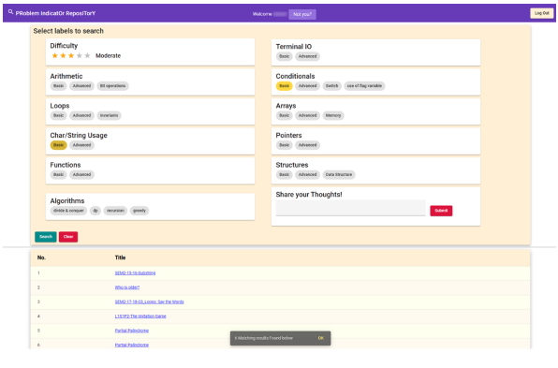
ML for Program Retrieval

Slide 29
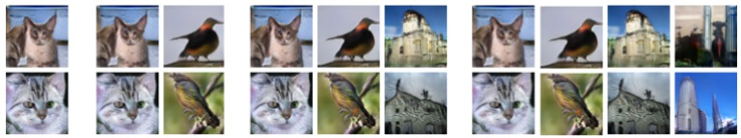
Lifelong Learning
Lifelong Deep Generative Models (without forgetting)

Slide 30
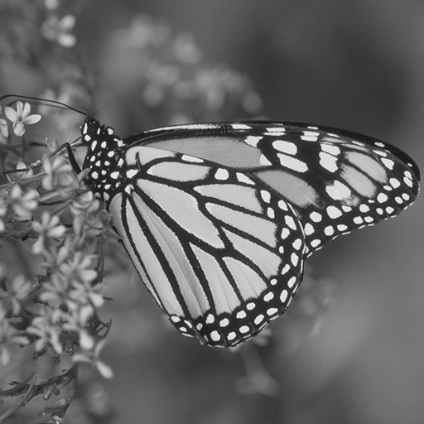
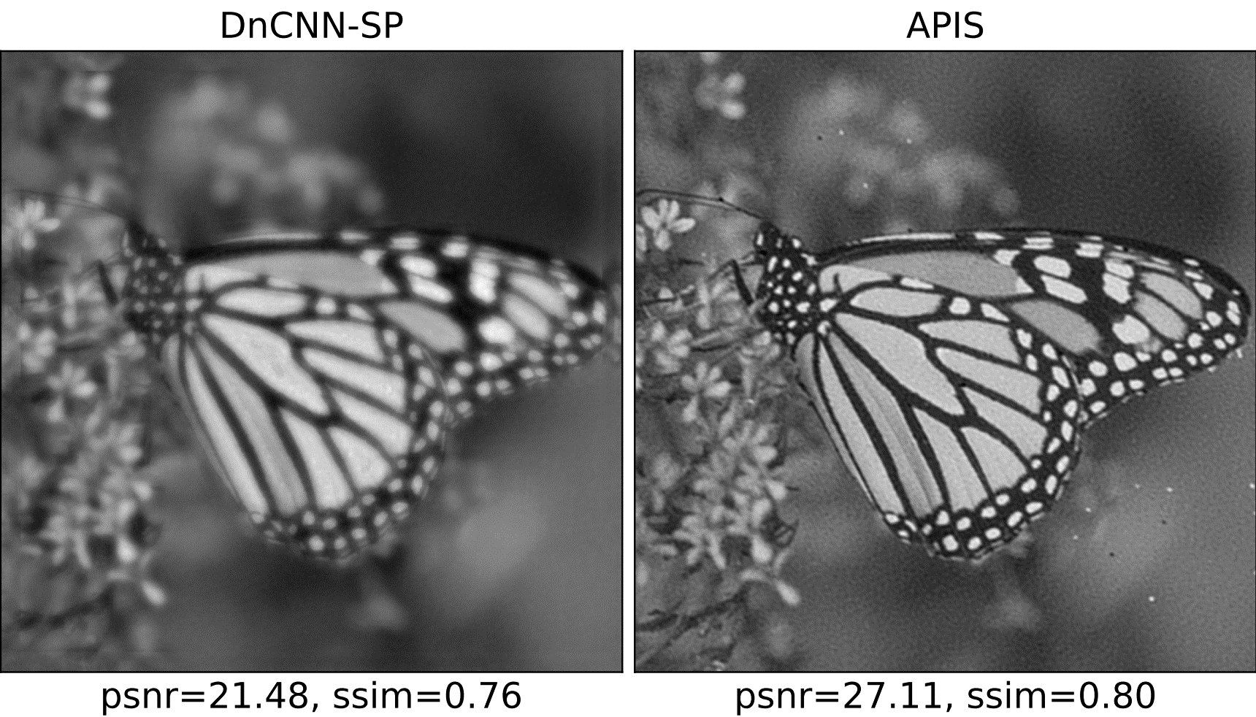
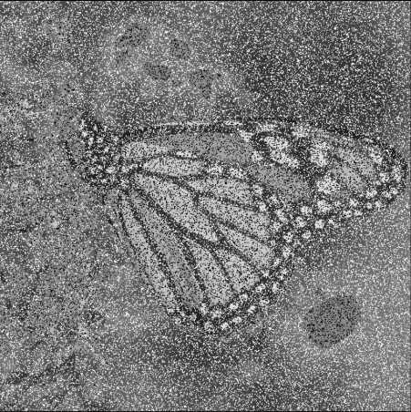
Image Denoising
Original
Poisoned

Slide 31
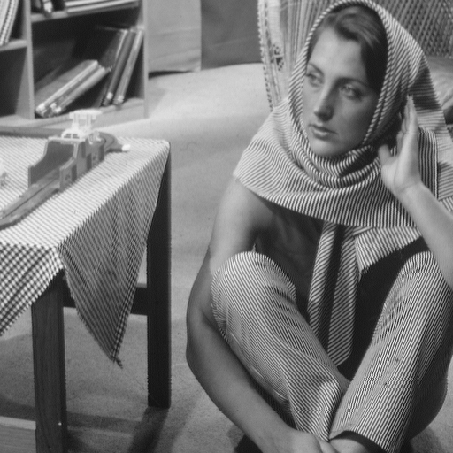
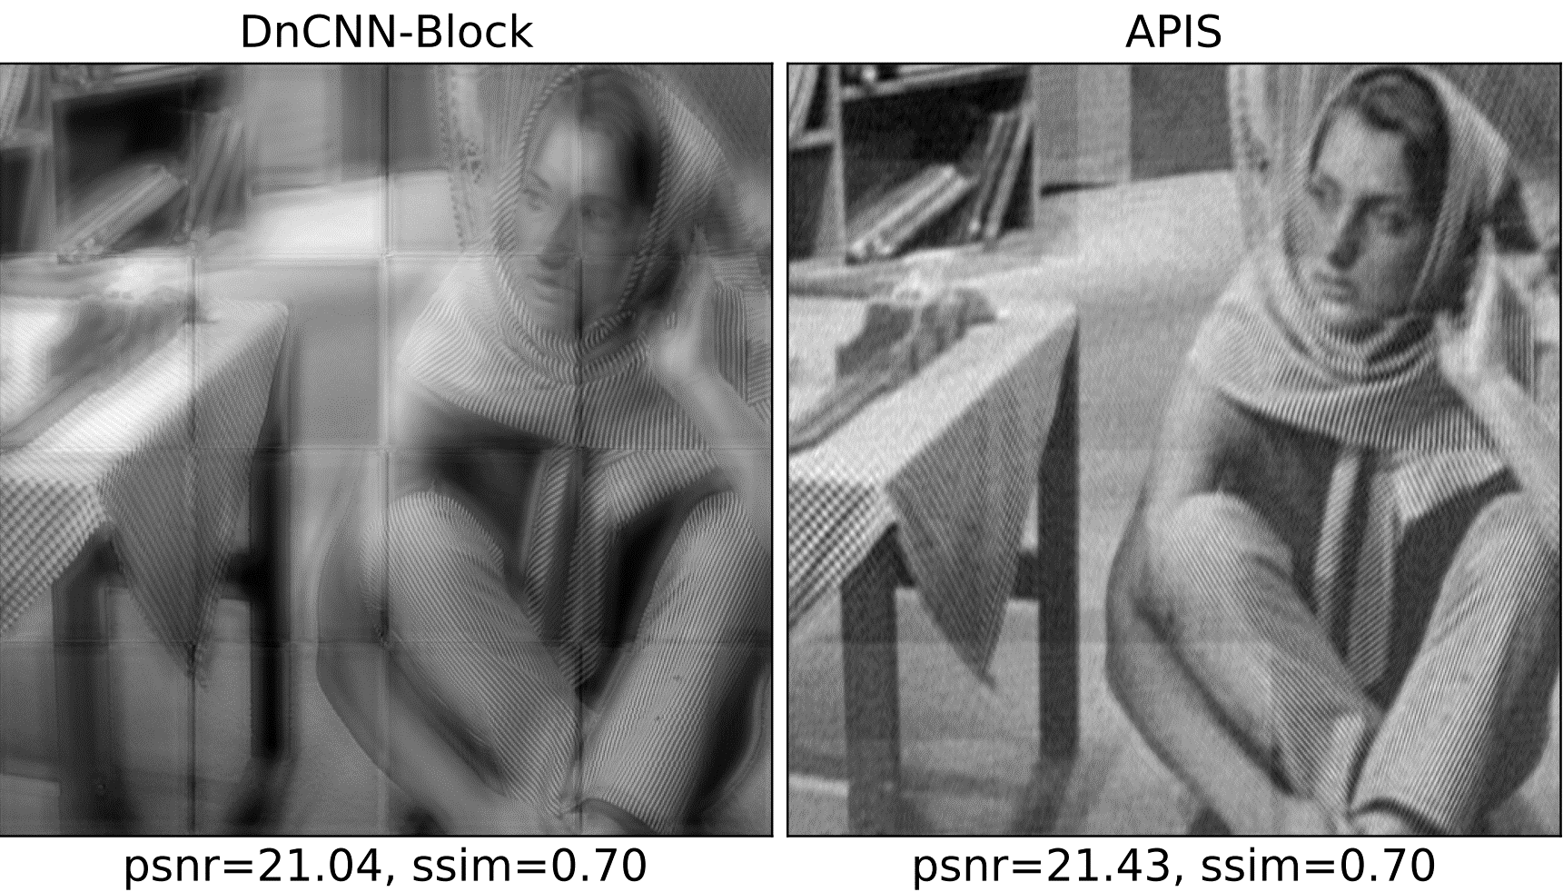
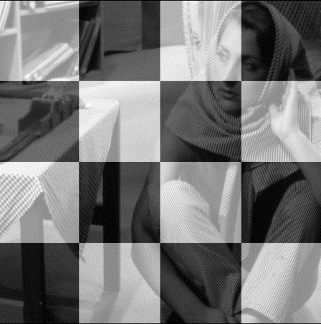
Image De-watermarking
Original
Poisoned

Slide 32
Stay Awesome!
See you in the next one

